Slide 1
University of Pretoria
AN ASSESSMENT OF THE IMPACT OF MEGATRENDS IN THE TOURISM SECTOR
Research Project 2018-2019
October 2020
Presenter: Berendien Lubbe
Department Historical and Heritage Studies
Anneli Douglas
Department Marketing Management

Slide 2
Overall aims of the study
Aim 1: To identify and analyze global shifts and megatrends that impact the tourism industry in South Africa
Our methodology
Horizon scanning
Evidence-based data
Interviews with industry and Government experts
Identification of key uncertainties and assumptions
Workshop
Notes:
To

Slide 3
Outcome
Five mega-trends that impact SA’s tourism sector:
Economic
Political
Social
Technological
Environmental
Four scenarios for South Africa’s tourism future

Slide 4
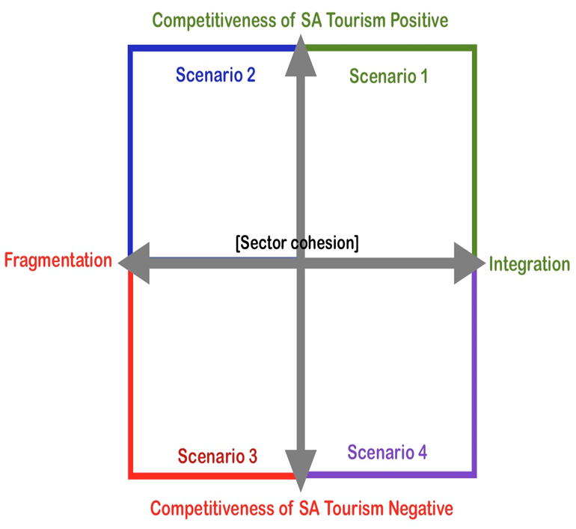

Slide 5
Aim 2: To develop a framework that will enable the sector to proactively respond to the challenges of the impacts of mega-trends and capitalise on opportunities for future development of sustainable tourism over time.
Our methodology
Practices in other countries
UK, Scotland, Australia, Qatar, Finland
Literature on models and best practices
Interviews industry and Government tourism experts, locally and abroad
First draft theoretical model
Workshops to refine and test the Model

Slide 6
Outcome
Framework/Model:
Demonstrating a continuous, dynamic and iterative process
Structure driven at the highest level
Reflecting multi-stakeholder collaboration as central to the process
Made up of several interacting components
Influenced at every stage by external signals
Highlights continuous open communication
“Destinations need to develop a comprehensive government and industry response to megatrends”

Slide 7
Indicators
Agenda setting
Megatrend identification
Scenario construction
Monitoring
Indicators
Evaluation and monitoring
Institutional structure
Policy formulation
Indicators
Communication
Execution
Scenario analysis
Policy decisions
Indicators
The process and components for responding to megatrends

Slide 8
Institutional
Structure
Formal, permanent core unit (examples)
Strategic Planning Forum
Driven at highest level
Representation
Industry
Government (multi-levels)
Research Institutions/Academics
Communities
Ad hoc experts
Dependent on trend
Awareness of conflicting objectives

Slide 9
Indicars / Signals
Indicators / Signals
Emerging trends
Early warning signs
Weak signals
Wild cards

Slide 10
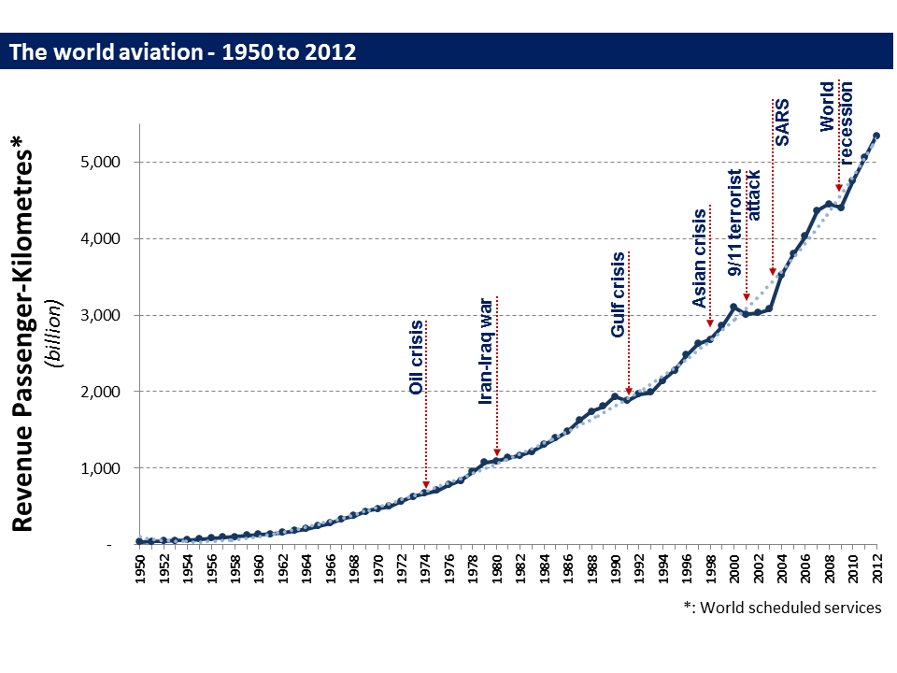

Slide 11
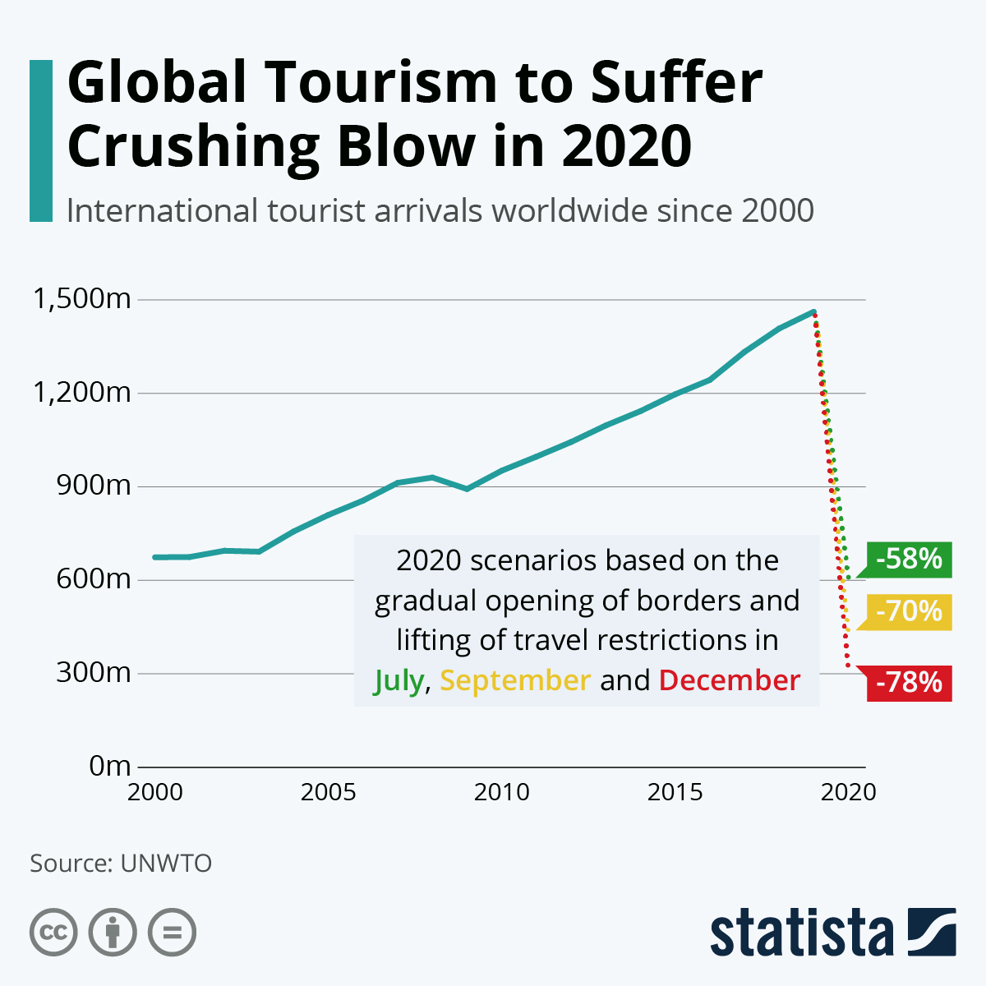
COVID-19
LOCKDOWN!

Slide 12
Agenda Setting
Mega-trend
Identification
Economic
Political
Social
Technological
Environmental
Assess probable magnitude
Prioritise mega-trends
Set overall policy goals, regulatory framework
Adopt long-term approach
Use evidence to build scenarios

Slide 13
Scenario
Construction
Visualise the future through alternative scenarios resulting from a combination of trends and policies, allowing policy-makers to involve multiple stakeholders and test policies against scenarios.

Slide 14
Policy
Decisions
Policy
Decisions
Policy
Formation
Communication
Evaluation
and
monitoring
Execution of Policies
Notes:
“Effective public policy and programmes should go beyond achieving the objective of improving society’s welfare and its distribution to also assist economic agents in coping with risks and turning challenges into opportunities. Moreover, a broad swathe of issues affected by global megatrends is likely to generate externalities, which can be directed and mediated through effective policymaking.”
A government uses policy instruments when wanting to change society. There are four basic resources that the government possesses in the implementation of policies (Halkier, 2006):
Authority: the token of authority that gives governments the power to officially demand or prohibit something;
Information: which is the collection and distribution of information for various purposes;
Finance: which is money or other financial resources that the Government can use to provide incentives or aid; and
Organisation: which is the coordination of physical and human capital and most often used in combination with one or more of the three other instruments. Organisational instruments give governments the possibility to act directly and control an issue.
(Permani et al., 2017: 142)

Slide 15
Conclusion
2020
What could have been different?

Slide 16
THANK YOU
berendien.lubbe@up.ac.za
Department Historical and Heritage Studies
University of Pretoria

